Slide 1
What Foreign Exchange Risk?
Creating an Environment for Boosting Investor Confidence:
A Practitioner’s Perspective

Slide 2
Objectives
Examine some key market characteristics
The nature of Foreign Exchange risk in our market
Suggestions to Improve our attractiveness

Slide 3
Key Market Characteristics
Predominantly centralized spot dealer market
Under-developed forward foreign exchange and derivatives market
Limited inter-bank trading
Sign of the existence of a small parallel market

Slide 4
Key Market Characteristics
Mainly US dollar trade
Low market transparency
Limited scope for price discovery
Significant inter-regional trade

Slide 5
Customer
Bank
Foreign Exchange Risk
Central Bank

Slide 6
Reduced Conversions

Slide 7
Increased Purchases from CBTT

Slide 8
TTD/USD Rate Movement

Slide 9
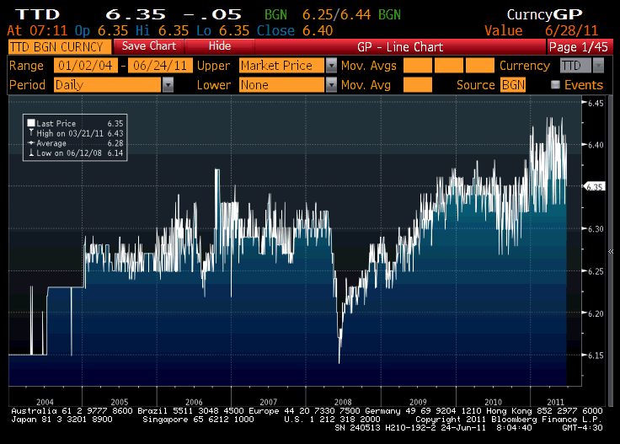

Slide 10
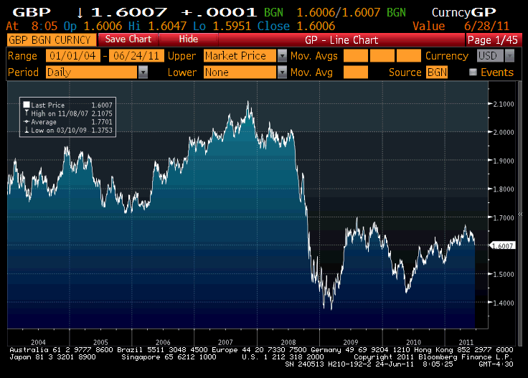

Slide 11
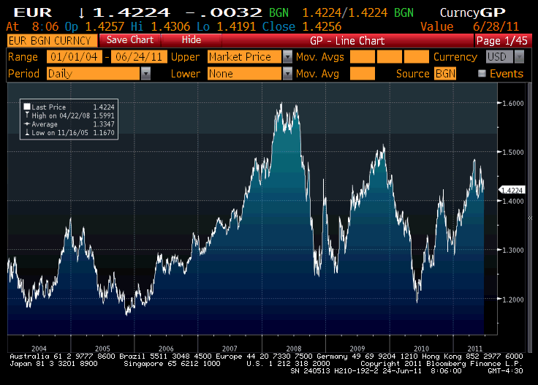

Slide 12
Challenges
Managing increasing exchange rate risk
Heightened competition for scarce dollars
The allocation problem
Managing the increased speculation
Maintaining stable exchange rate

Slide 13
What is needed?
Need for greater transparency
Development of the Forward Exchange and derivative market
Move to a more decentralized dealer market
Collaboration between regional banks to unblock cash-flows and support trade

Slide 14
Thank You

